Slide 1

Department Of Electronics and Telecommunication Engineering
A Presentation on : Enemy Intrusion Detector
IN THE PARTIAL FULFILLMENT FOR THE AWARD OF THE DEGREE OF
BACHELOR OF ENGINEERING IN ELECTRONICS AND TELECOMMUNICATION
Presented By:
1.Krishna Shah
2.Prajwal Joshi
3.Tirth Shah
Guided By: Dr. M.P. Sardey

Slide 2
Contents
Introduction
Problem Statement
Aim and Objectives
Component Selection
Block Diagram
Methodology
Literature Survey
Current status of work

Slide 3
INTRODUCTION
Vibershield is a intrusion detection system using a network of underground seismic sensors laid out in a perimeter around a secure camp/location.
The system will be capable of detecting footsteps, vehicles and other types of intrusion which may try to enter the perimeter area.
Currently we are working on a single sensor system and developing techniques to detect the various characteristics of seismic activity generated from the possible inputs - footsteps, vehicles, multiple instances or combination of these.

Slide 4
PROBLEM STATEMENT
Intelligent Intrusion Detection
- Illegal Human Movement
- Vehicle and Material Movement
- Animal Intrusion
[1] Problem Statement by CME, Indian Army 25th Dec, 20

Slide 5
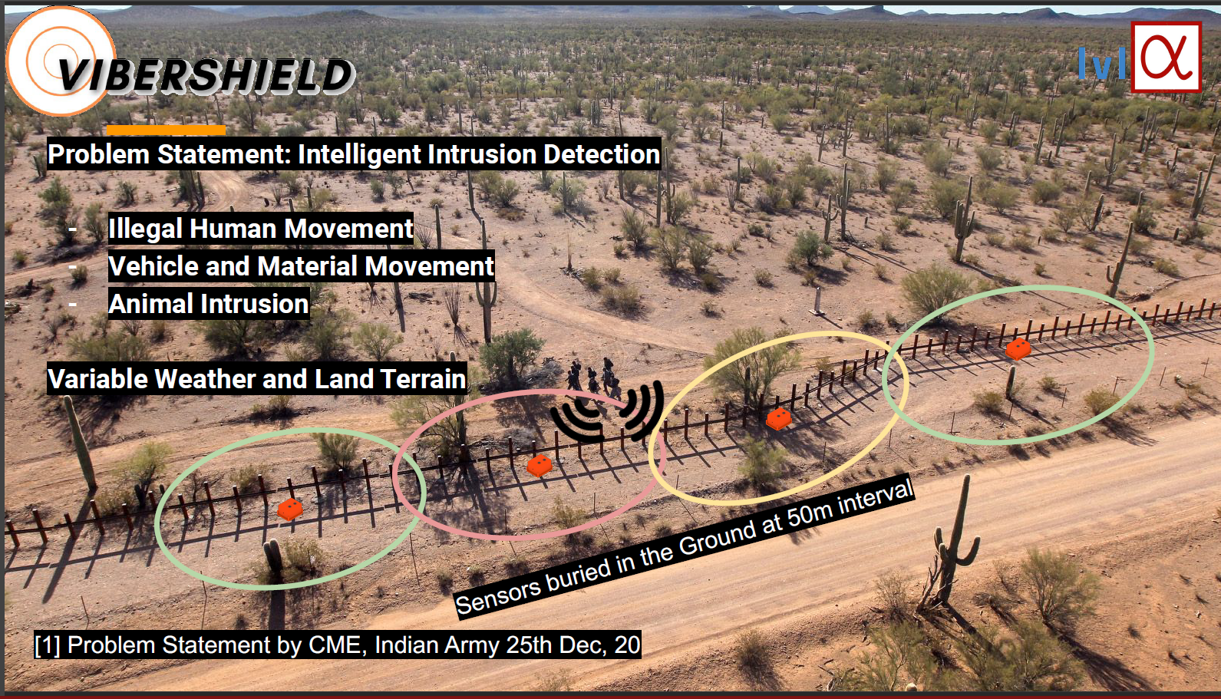

Slide 6
AIM AND OBJECTIVES
Aim: Monitoring of Illegal movements in restricted areas by terrain & subterranean methods by unauthorized people, vehicles, materials and animals. Objectives: 1. To build a system in which unauthorized entries are not allowed 2. To make a system which will be capable of detecting footsteps, vehicles and other types of intrusion which may try to enter the perimeter area. 3. To detect network of underground seismic sensors laid out in a perimeter around a secure camp/location.

Slide 7
Components selection
D7s sensor-
D7s Sensor is a seismic sensor which detects the vibrations in the smallest scale.
With their high detection accuracy, these Sensors help with measures to prevent secondary damage after earthquakes
Helps prevent fire and other secondary disasters after an earthquakeUsing SI value to provide higher-precision judgement of seismic intensity
Prolonged operation on battery power
I2C interface is able to obtain earthquake related information from the sensor with communication from external devices

Slide 8
ADS 1256 -
The ADS1255 and ADS1256 are extremely low-noise,24-bit analog-to-digital (A/D) converters. They provide complete high-resolution measurement solutions for the most demanding applications.
The converter is comprised of a 4th-order, delta-sigma(ΔΣ) modulator followed by a programmable digital filter.
A flexible input multiplexer handles differential or single-ended signals and includes circuitry to verify the integrity of the external sensor connected to the inputs.
Communication is handled over an SPI-compatible serial interface that can operate with a 2-wire connection.
APPLICATIONS-Scientific Instrumentation, Industrial Process ,Control Medical, Equipment Test and Measurement Weigh Scales

Slide 9
STEVAL-AETkt1V2
This is a current amplifier. We need current amplifier because the output given by d7s sensors is very small and we need to amplify it.
Wide common mode voltage range: -20 to 70 V
Offset voltage: ±200 μV max.
2.7 to 5.5 V supply voltage
Quiescent current: 20 μA in Shutdown mode
Temperature range: -40 to 125°C
SO8 and MiniSO8 package
RoHS compliant (Restriction of Certain Hazardous Substances)

Slide 10
AP7312-1533W6-7
This is a dc/dc converter which we are using to converts the output of the d7s sensor into the output which the processor can read.
The AP7312 is 150mA, dual fixed output voltage, low dropout linear regulator.
The AP7312 include the pass element, error amplifier, band-gap, current limit and thermal shutdown circuitry which protect the IC from damage in fault conditions.
The AP7312 has two enable pins (EN1 and EN2) to independently turn the respective channel on when a logic high level is applied.
The characteristics of low dropout voltage and low quiescent current make it suitable for low power applications. The typical quiescent current is approximately 60μA.
Applications-
Cellular Phones
• Smart Phones, PDAs
• MP3/MP4
• Bluetooth head set
• Low power application

Slide 11
MCP73831/2
The MCP73831/2 devices are highly advanced linear charge management controllers for use in space limited, cost-sensitive applications.
Along with their small physical size, the low number of external components required make the MCP73831/2 ideally suited for portable applications.
Applications:
Lithium-Ion/Lithium-Polymer Battery Chargers
Personal Data Assistants
Cellular Telephones
Digital Cameras
MP3 Players
Bluetooth Headsets
USB Chargers

Slide 12
Technical Specifications
Geophone with ADC - Analog devices AD7194
The AD7194 is a low noise, complete analog front end for high precision measurement applications. It contains a low noise, 24-bit sigma-delta (Σ-Δ) analog-to-digital converter (ADC).
The on-chip low noise gain stage means that signals of small amplitude can interface directly to the ADC.
The device can be configured to have eight differential inputs or sixteen pseudo differential inputs. The on-chip 4.92 MHz clock can be used as the clock source to the ADC or, alternatively, an external clock or crystal can be used.
The output data rate from the part can be varied from 4.7 Hz to 4.8 kHz.

Slide 13
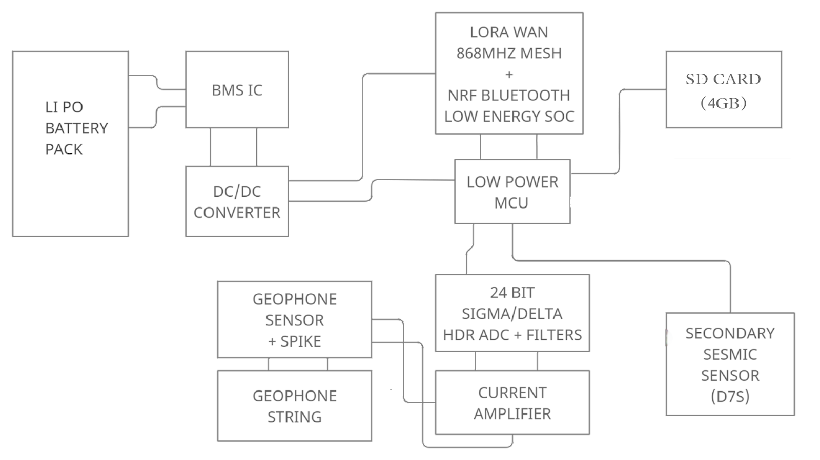
BLOCK DIAGRAM

Slide 14
METHODOLOGY
Currently we are working on a single sensor system and developing techniques to detect the various characteristics of seismic activity generated from the possible inputs - footsteps, vehicles, multiple instances or combination of these.
A grid of Fusion Underground Sensor with Wireless P2P communication and rechargeable Battery. The sensors are able to classify underground activity along with movement of human, animal, vehicle and heavy machinery.

Slide 15
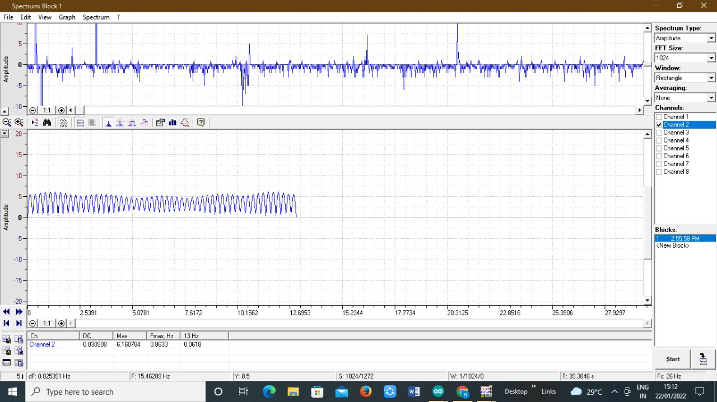
Test Results

Slide 16
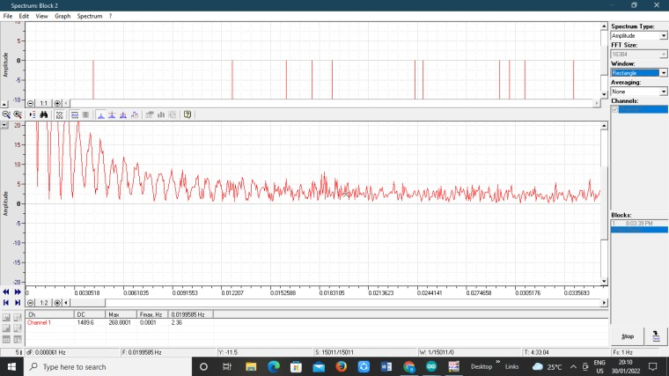

Slide 17
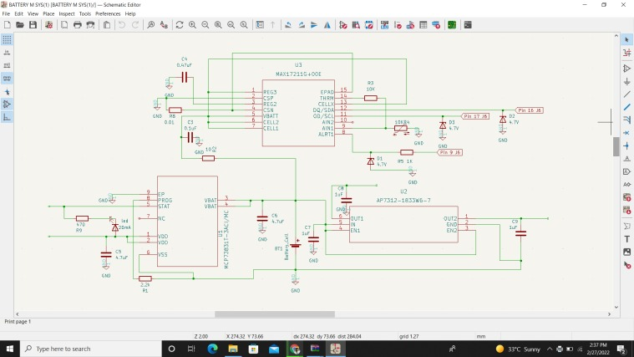

Slide 18
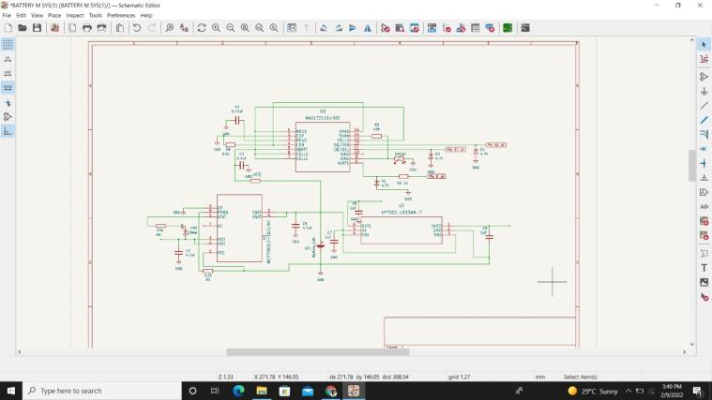

Slide 19
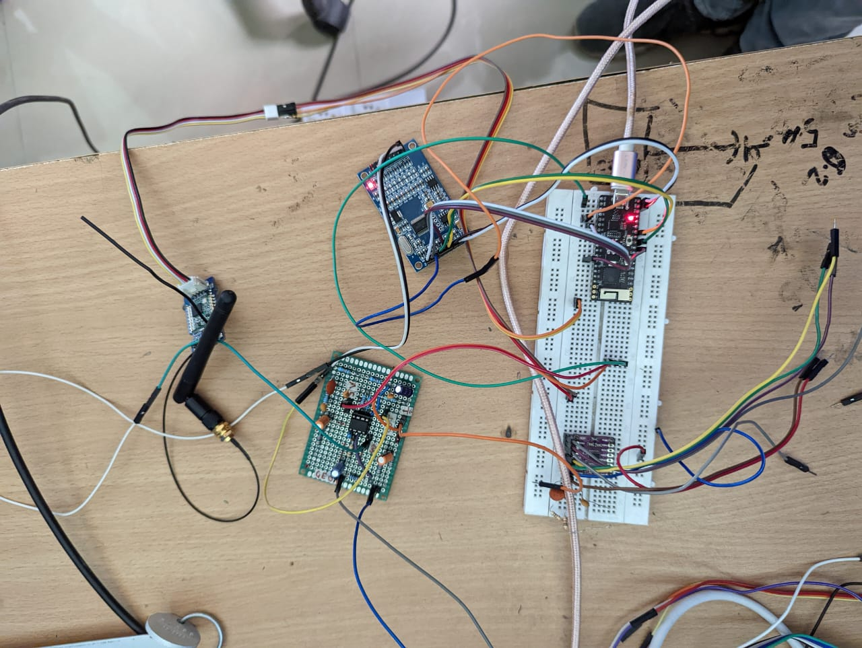

Slide 20
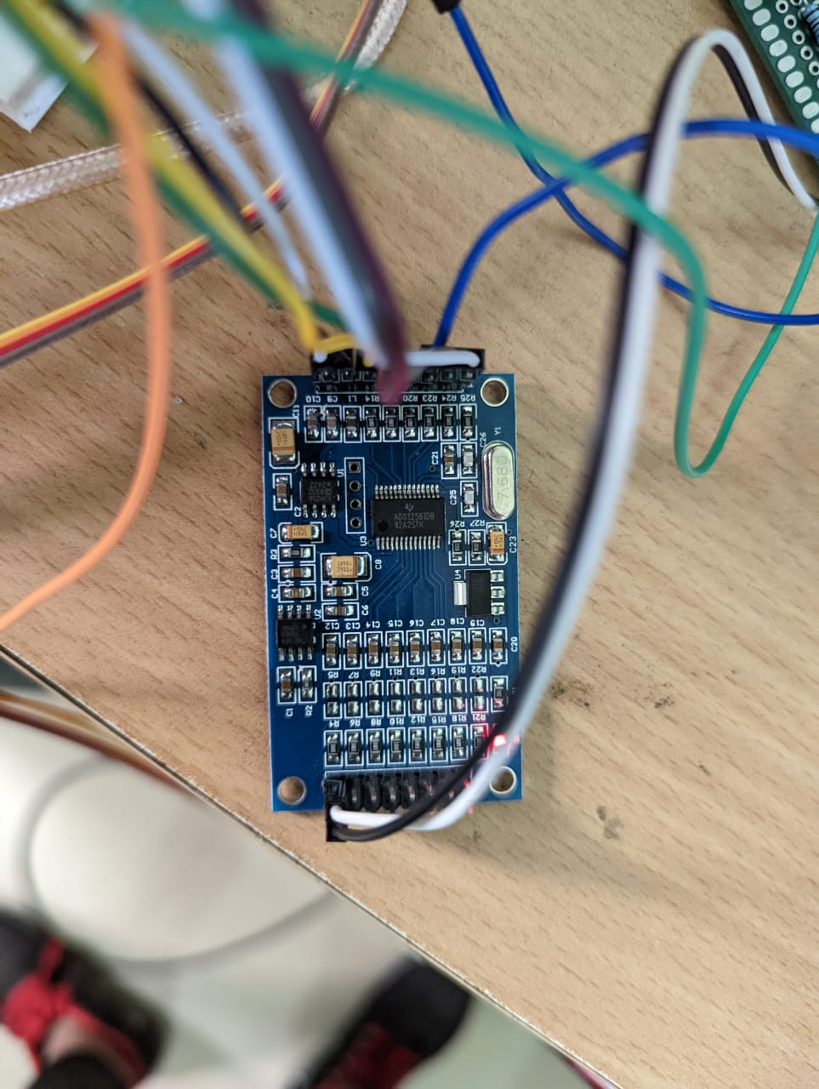

Slide 21
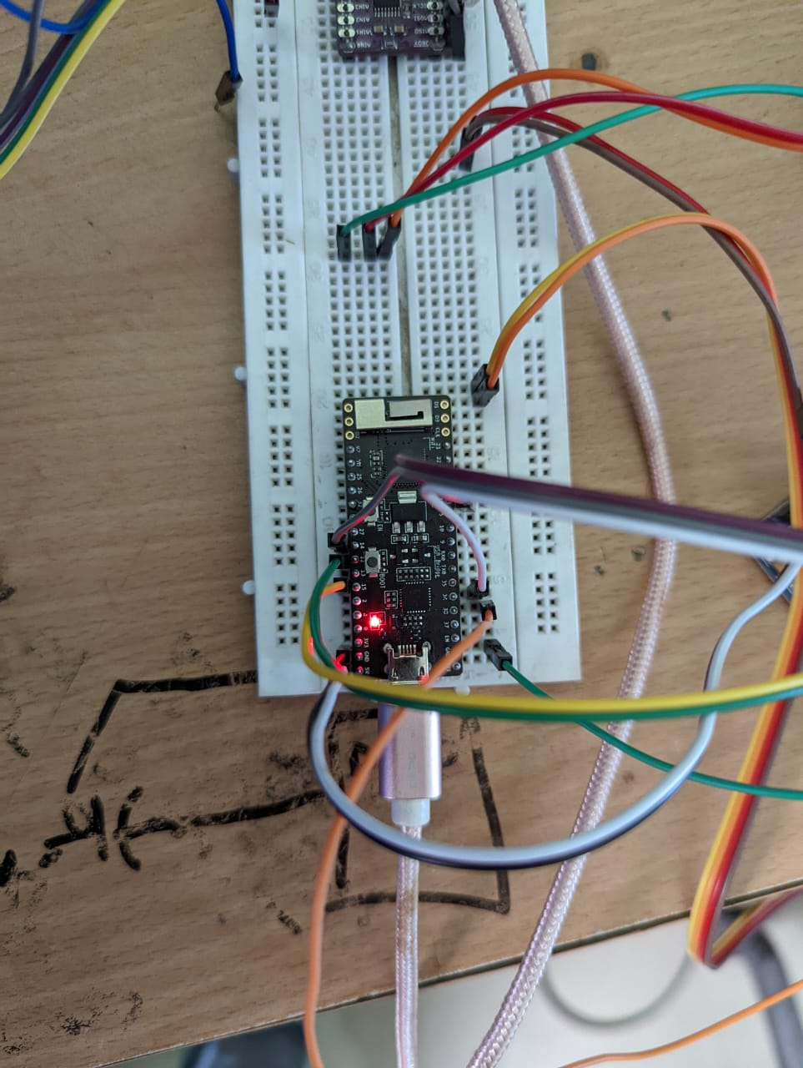
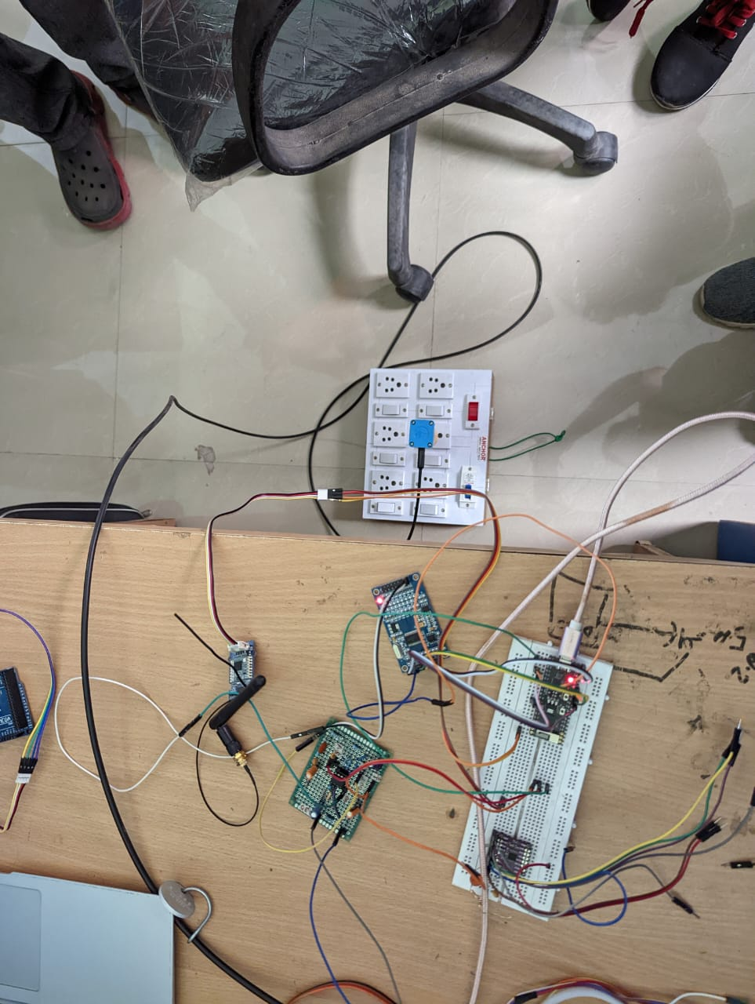

Slide 22
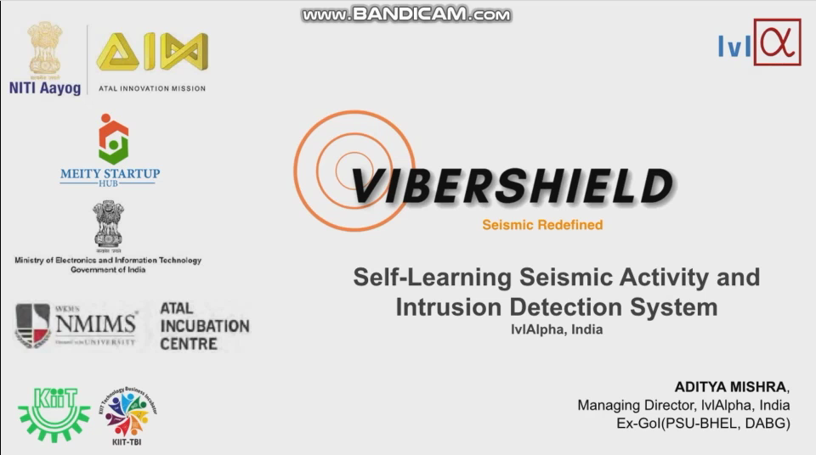

Slide 23
LITERATURE SURVEY
1- Calibration of Vibration sensors – Evaluation and Effectivization by VLADIMIR CHEVATCO
In this thesis, the calibration process of a geophone based vibration sensor is treated and optimized. The purpose of calibration is to estimate the physical parameters of the system in the form of gain, damping and eigen frequency.
Link- http://www.diva-portal.org/smash/record.jsf?pid=diva2%3A1146233&dswid=-2888
2- Footstep Detection and Tracking
George Succi, Daniel Clapp, Robert Gampert, Gervasio Prado, SenTech, Inc. Stoneham, MA 02180
Persons or vehicles moving over ground generate a succession of impacts; these soil disturbances propagate away from the source as seismic waves. These seismic waves are especially useful in detecting footsteps which cannot be detected acoustically. Footstep signals can be distinguished from other seismic sources, such as vehicles or wind noise, by their impulsive nature.
Link- https://www.researchgate.net/publication/239534098_Footstep_detection_and_tracking

Slide 24
Border Surveillance and Intruder Detection
Using Wireless Sensor Networks: A Brief Survey by Arjun D, Indukala P K and K A Unnikrishnan Menon
Intrusion of terrorists and trespassers are adversely affecting the peace and harmony in the nation. The fatalities and disturbances caused by various terrorist attacks in Indian Army Camp show the necessity of an efficient border surveillance and intruder detection system for the effective monitoring and detecting the unauthorized movement of intruders across the national borders.
Link - https://www.academia.edu/36869218/Border_Surveillance_and_Intruder_Detection_Using_Wireless_Sensor_Networks_A_Brief_Survey

